Slide 1

MALLA REDDY COLLEGE OF ENGINEERING & TECHNOLOGY (Autonomous Institution – UGC, Govt. of India) DEPARTMENT OF COMPUTER SCIENCE AND ENGINEERING
CREATING MULTI-COLORED LIGHTS USING ARDUINO
Under the guidance of
MS.R.SUJATHA
Assistant professor
Batch No: C21
Pulavarthi Manoj Kumar (21N31A05J9)
Pothuganti Yugeshwar (22N35A05J8)
Nalla Abhinav (21N31A05F7)

Slide 2
ABSTRACT
The project "Creating Multi-colored Lights using RGB LED and Arduino" explores the integration of micro-controller technology with RGB LED systems to produce a versatile and cost-effective lighting solution. By leveraging the Arduino platform, this project demonstrates how precise control of red, green, and blue light-emitting diodes can generate a vast spectrum of colors through additive color mixing. The Arduino microcontroller enables dynamic programming of LED behaviour, including color transitions, intensity modulation, and interactive features, making it ideal for applications ranging from decorative lighting to educational demonstrations.

Slide 3
INTRODUCTION
Creating multi-colored light using Arduino is an exciting project that leverages the power of RGB LEDs and the versatility of Arduino microcontrollers. By combining red, green, and blue LEDs, users can create a wide spectrum of colors through digital control. This project typically involves programming the Arduino to control the brightness of each color channel, allowing for smooth transitions and dynamic light effects. It's an excellent introduction to both electronics and programming, offering hands-on experience in working with circuits, sensors, and coding to manipulate light for creative and practical applications.

Slide 4
EXISTING SYSTEM
Traditional lighting systems often rely on simple, single-color LEDs or mechanical switches, providing limited control over lighting color or effects.
These systems typically require manual adjustments for brightness and color, and their functionality is static, offering no flexibility for dynamic or customizable light patterns.
Additionally, such systems lack integration with modern technologies like sensors or smart devices, limiting their adaptability and user interaction.

Slide 5
PROPOSED SYSTEM
The proposed system utilizes an Arduino microcontroller to control RGB LEDs, allowing users to dynamically adjust the intensity of red, green, and blue light to create a wide range of colors and lighting effects.
Through programming and the use of Pulse Width Modulation (PWM), this system enables customizable light setups with smooth transitions between colors.
It introduces flexibility, energy efficiency, and the potential for integration with smart technologies, opening up possibilities for interactive lighting solutions in various applications like home automation, events, and artistic displays.

Slide 6
SOFTWARE AND HARDWARE REQUIREMENTS
Hardware Specifications
Microcontroller
LED Module
Power Supply
Resistors
Jumping wires
Software Specifications
IDE
Programming Language
Libraries
Operating System
Firmware

Slide 7
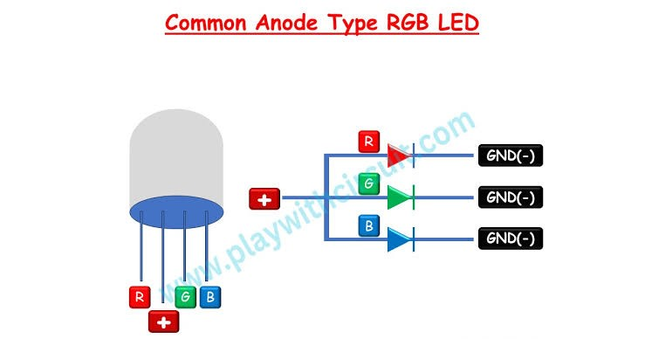
UML DIAGRAM: Common Anode GBR LED

Slide 8
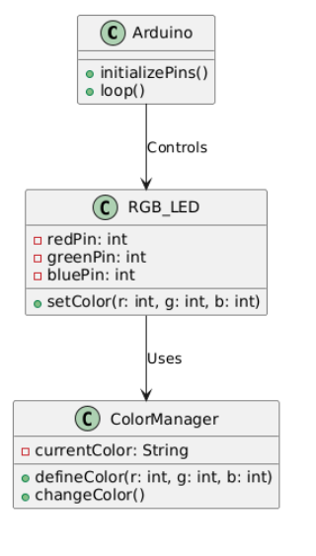
CLASS DIAGRAM

Slide 9
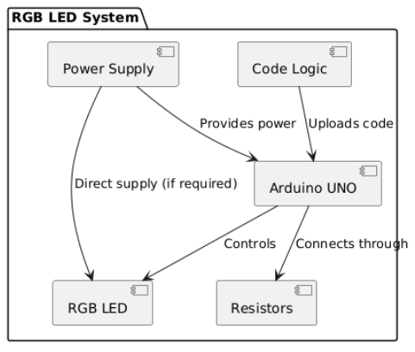
COMPONENT DIAGRAM

Slide 10
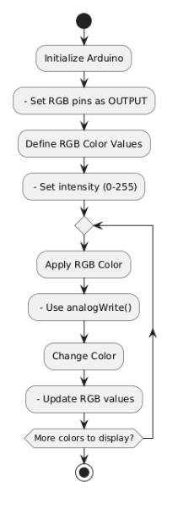
ACTIVITY DIAGRAM

Slide 11
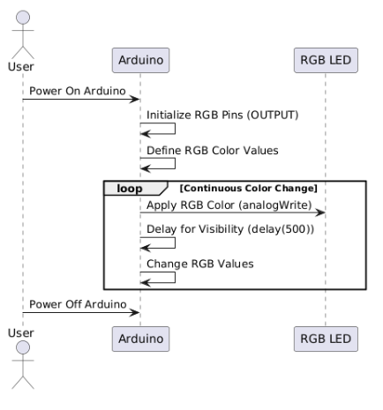
SEQUENCE DIAGRAM

Slide 12
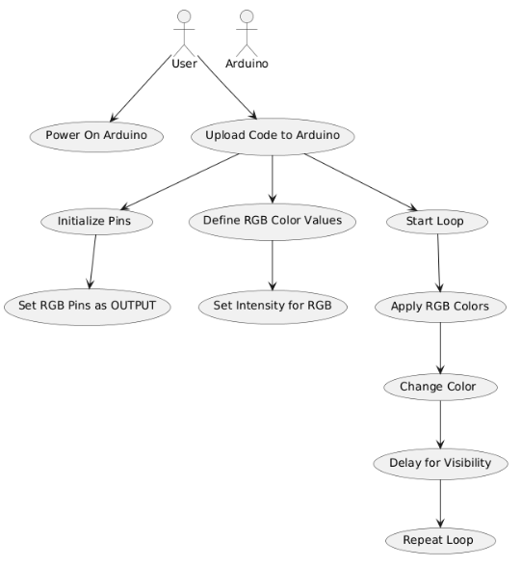
USE CASE DIAGRAM

Slide 13
THANK YOU

